Slide 1
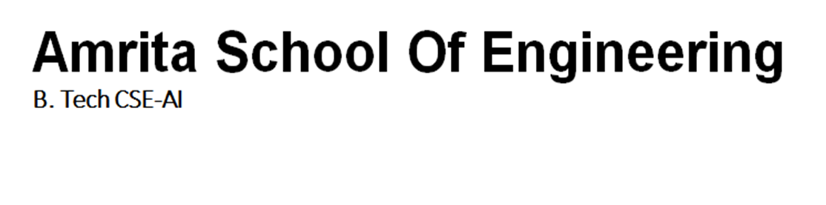

Semester -1 Physics Project

Slide 2
Presentation by
Batch - 4
DIVITH PHOGAT – AIEA.14193
GARAPATI VENKATA KRISHNA – AIEB.24735
JAYANTH M – AIEB.10655
KARNATI SAI PRASHANTH – AIEB.25264
MANISH RAMA GOPAL NADELLA - AIEB.12015

Slide 3
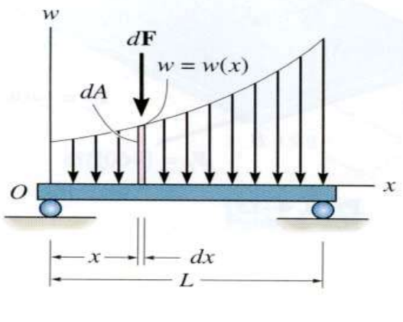
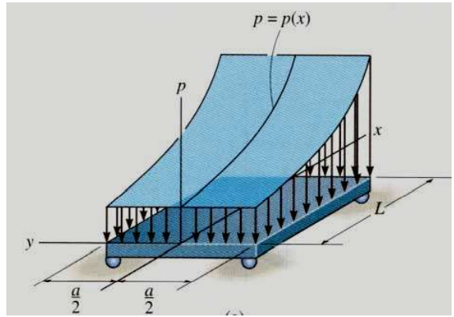
Concept:
DISTRIBUTED LOADING
In many situations a surface area of a body is subjected to a distributed load. Such forces are caused by winds, fluids, or the weight of items on the body’s surface. We will analyse the most common case of a distributed pressure loading. This is a uniform load along one axis of a flat rectangular body. In such cases, w is a function of x and has units of force per length.

Slide 4
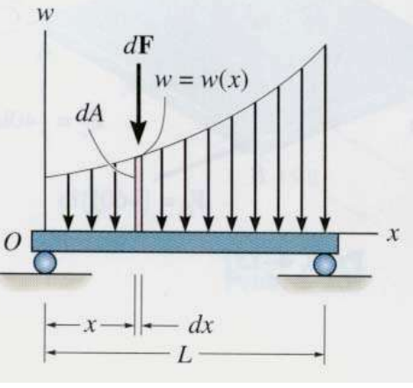
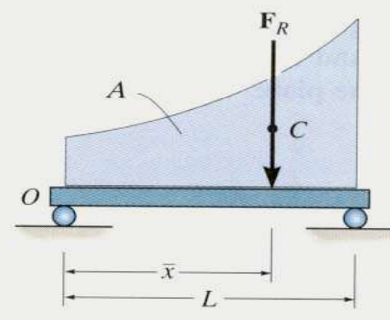
Introduction
MAGNITUDE OF RESULTANT FORCE
Consider an element of length dx. The force magnitude dF acting on it is given as
dF = w(x) dx
The net force on the beam is given by
+ ↓ FR = ∫L dF = ∫L w(x) dx = A
Here A is the area under the loading curve w(x).

Slide 5
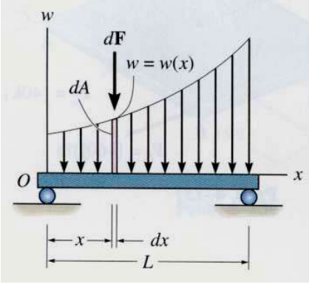
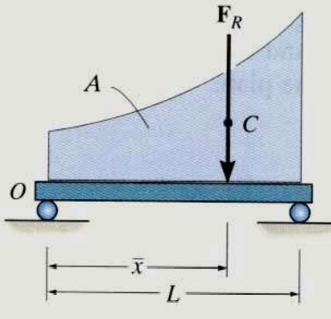
LOCATION OF THE RESULTANT FORCE
The force dF will produce a moment of (x)(dF) about point O. The total moment about point O is given as + MRO = ∫L x dF = ∫L x w(x) dx Assuming that FR acts at 𝑥 , it will produce the moment about point O as + MRO = (𝑥 ) (FR ) = 𝑥 ∫L w(x) dx

Slide 6

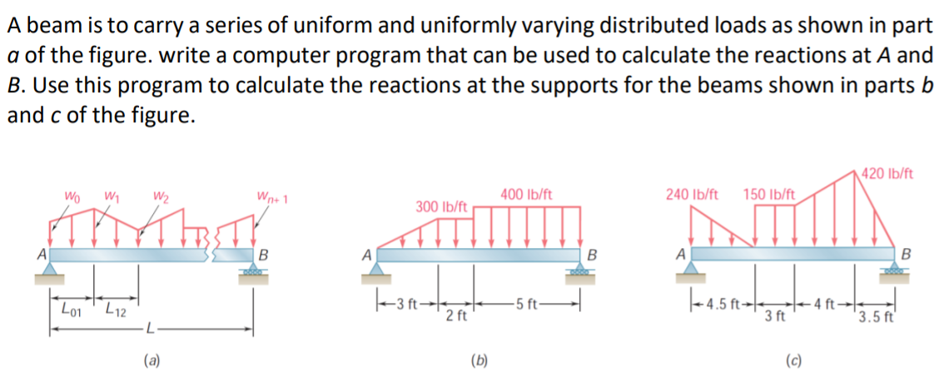
Given question:

Slide 7

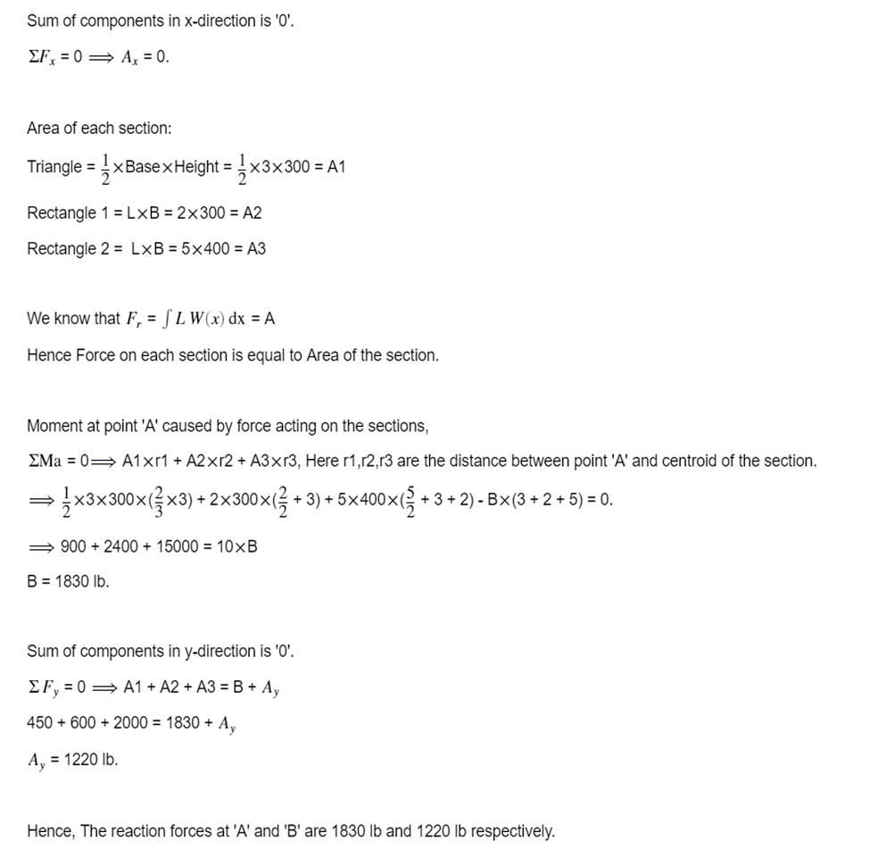
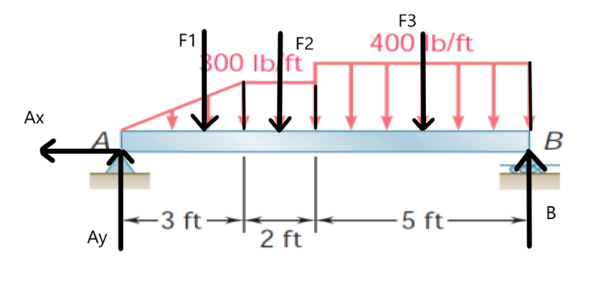
Solution: Solving without program:
Solution for (b):
Free body diagram

Slide 8

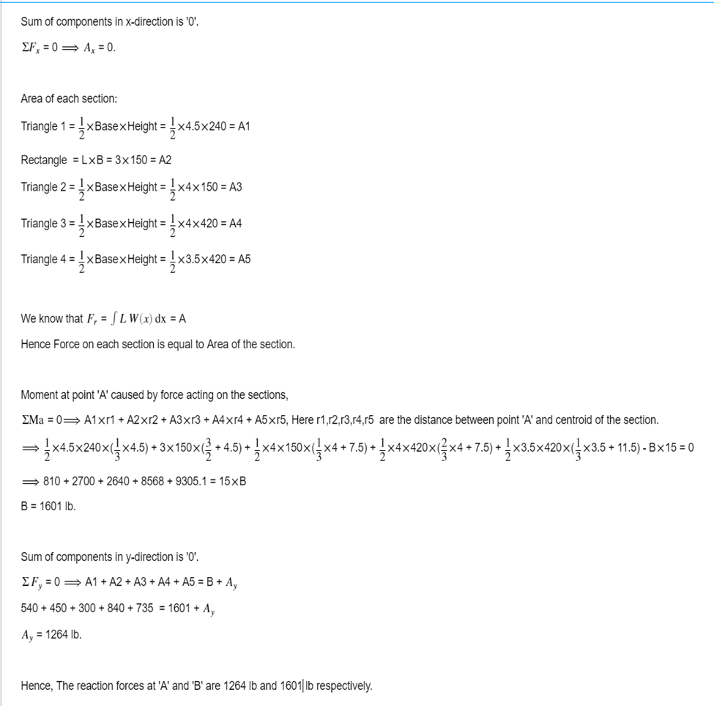
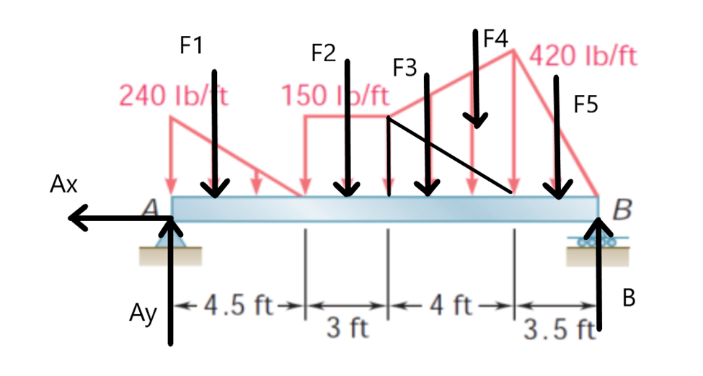
Solution for (c):
Free body diagram

Slide 9
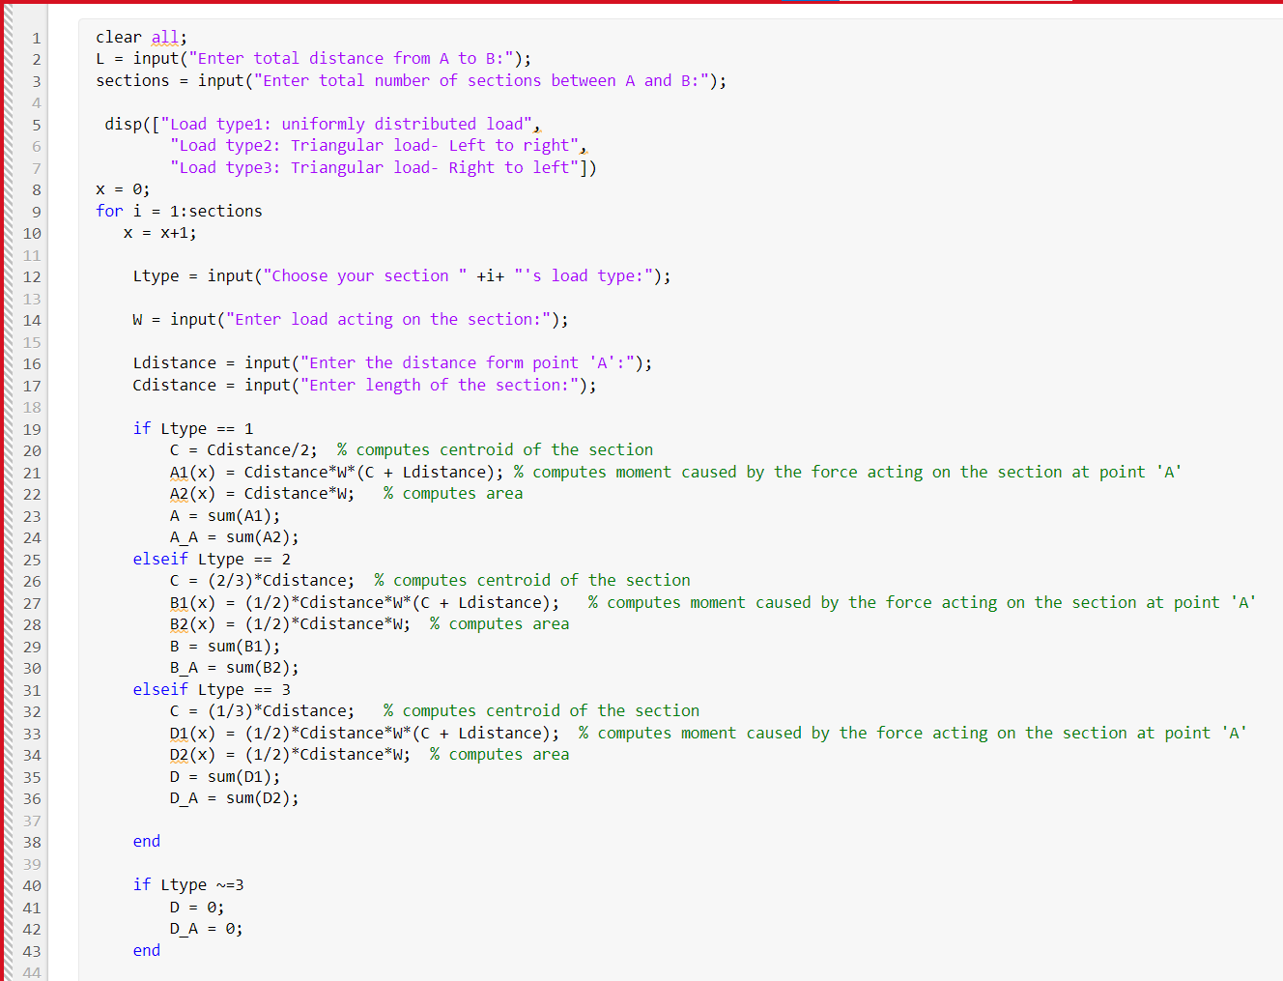
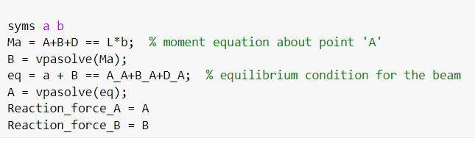
MATLAB code:

Slide 10
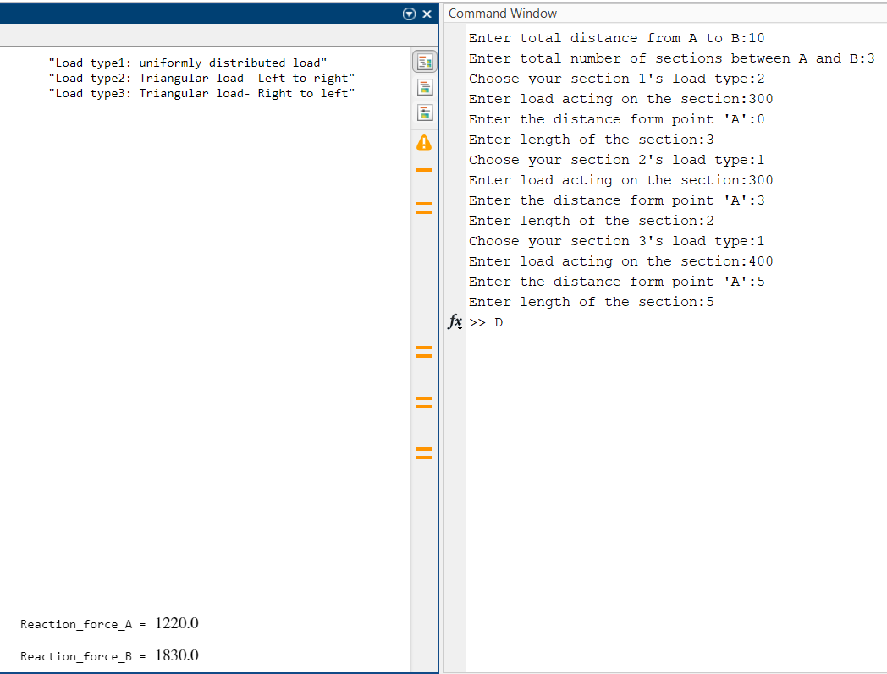
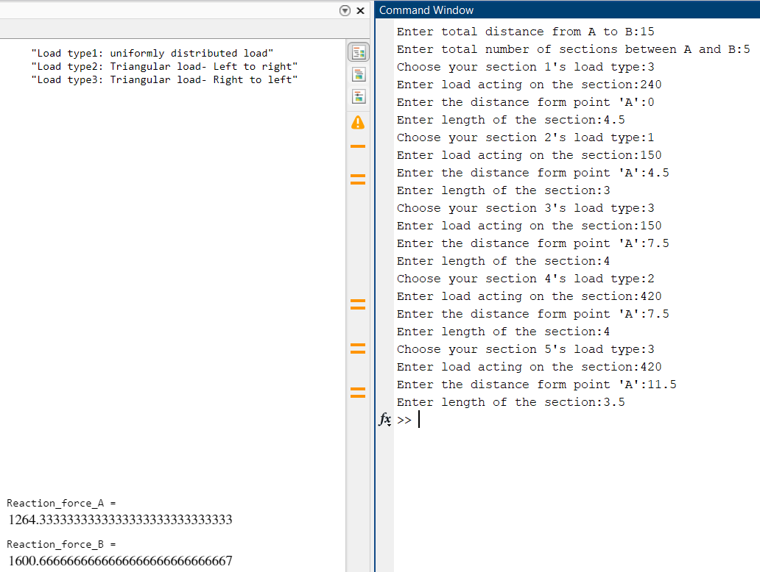
Solution for (b) using the above code:
Solution for (c) using the above code:

Slide 11
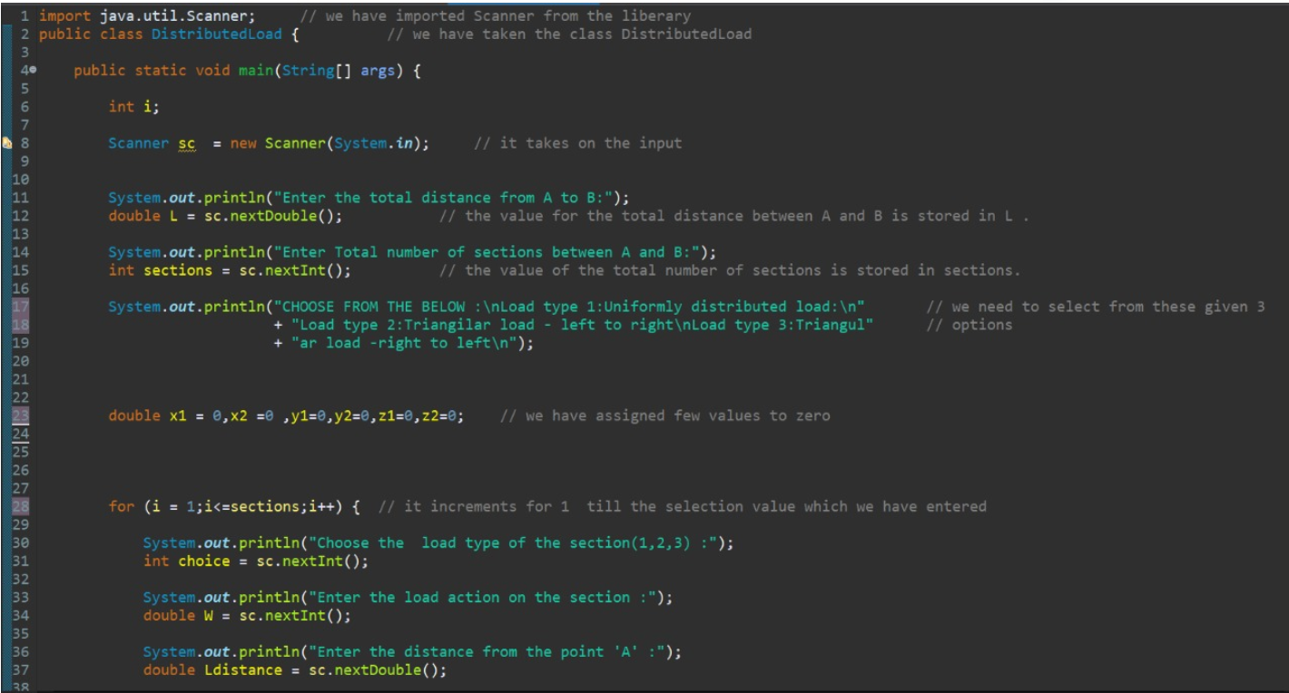
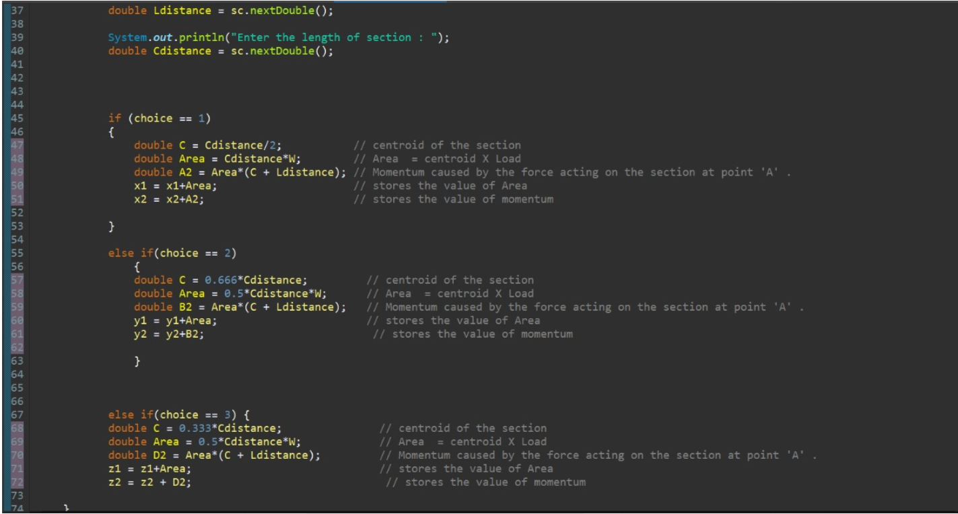
JAVA code:

Slide 12
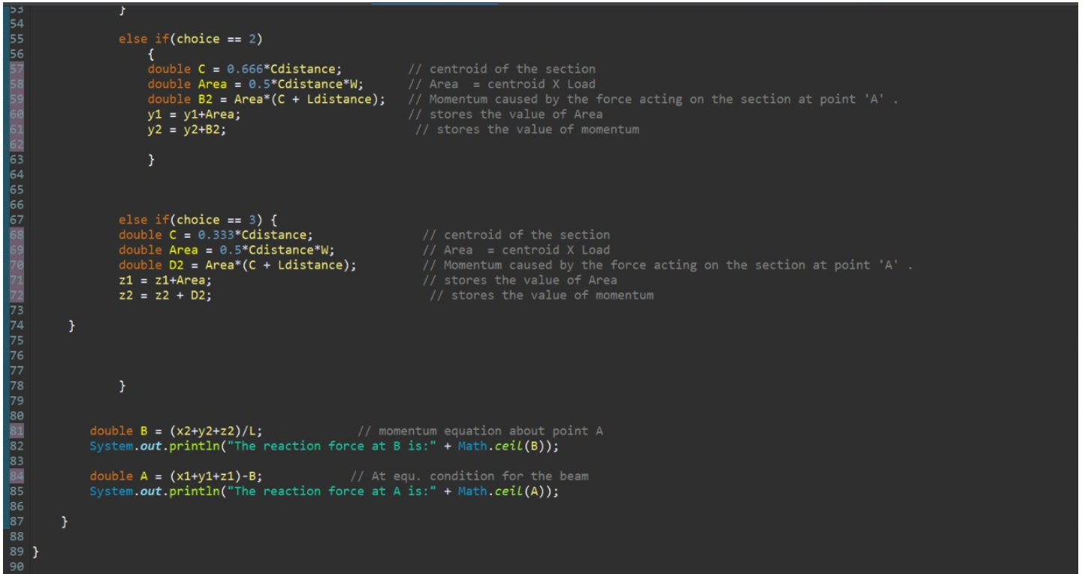

Slide 13
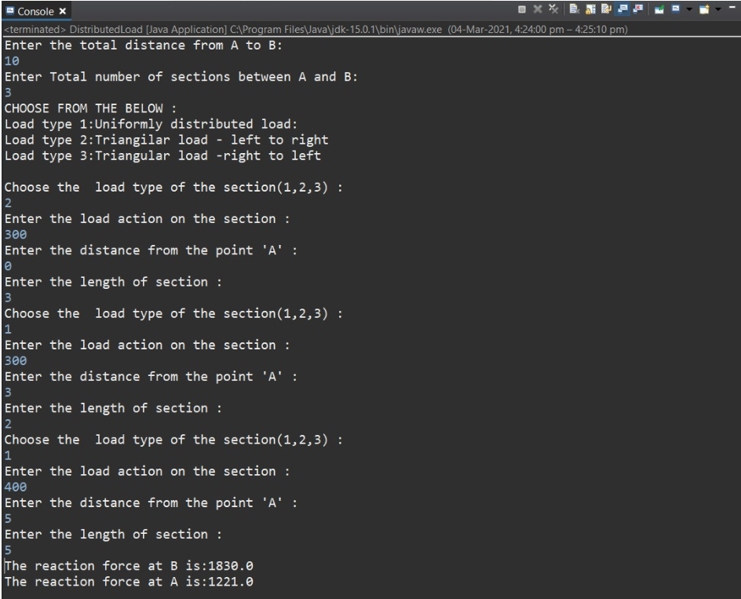
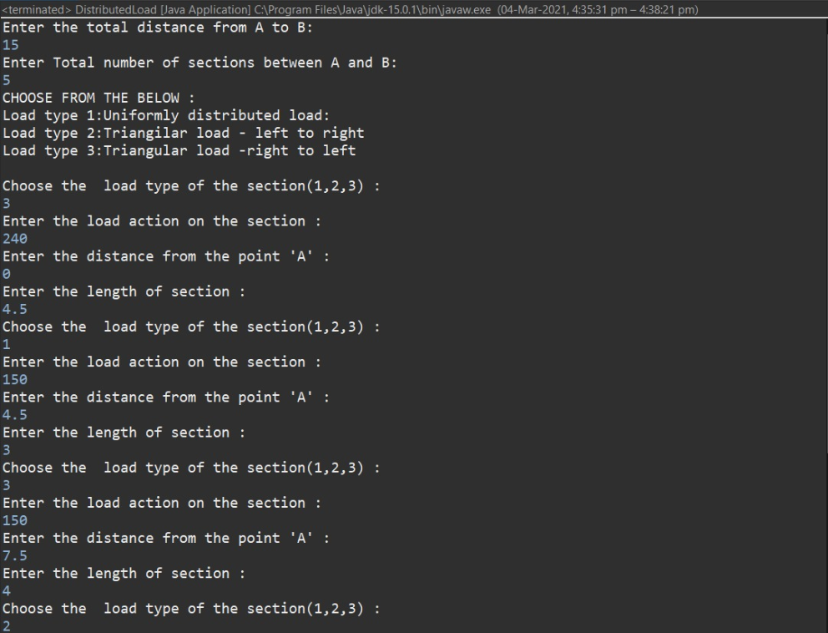
Solution for (b) using the above code:
Solution for (c) using the above code:

Slide 14
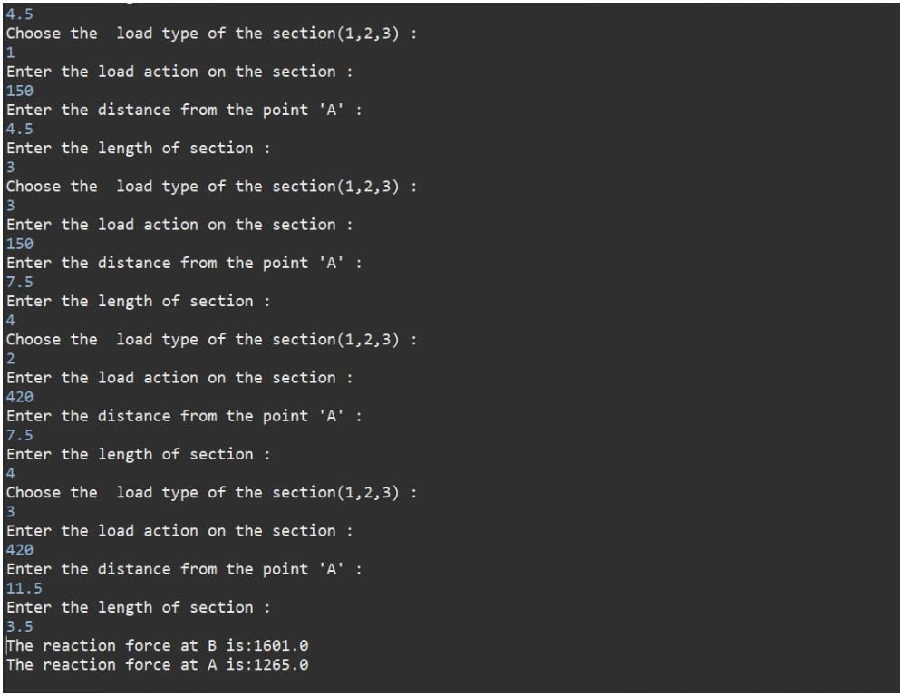

Slide 15

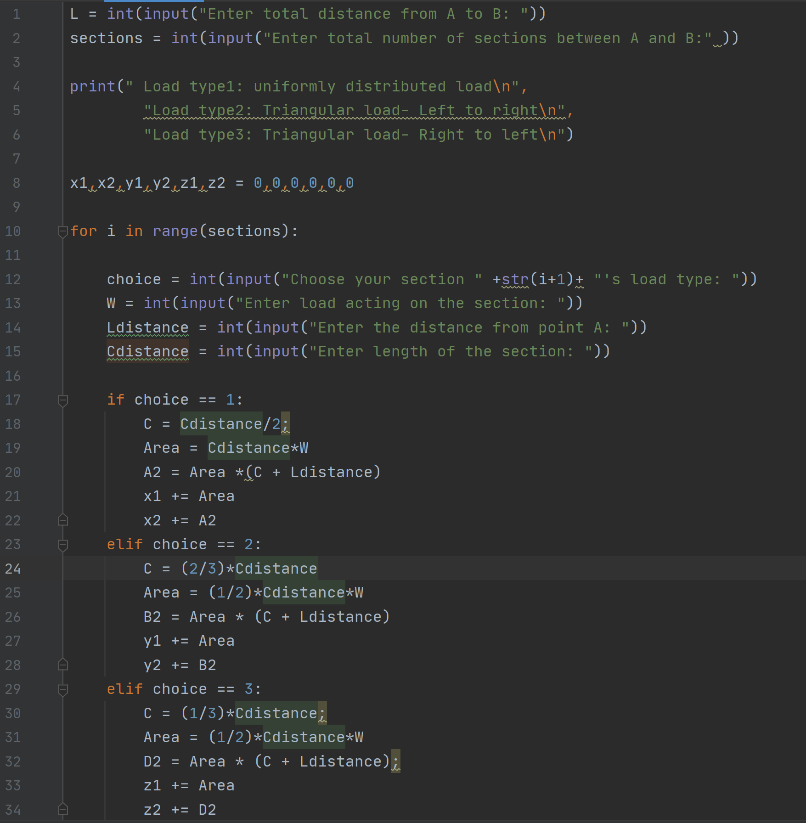
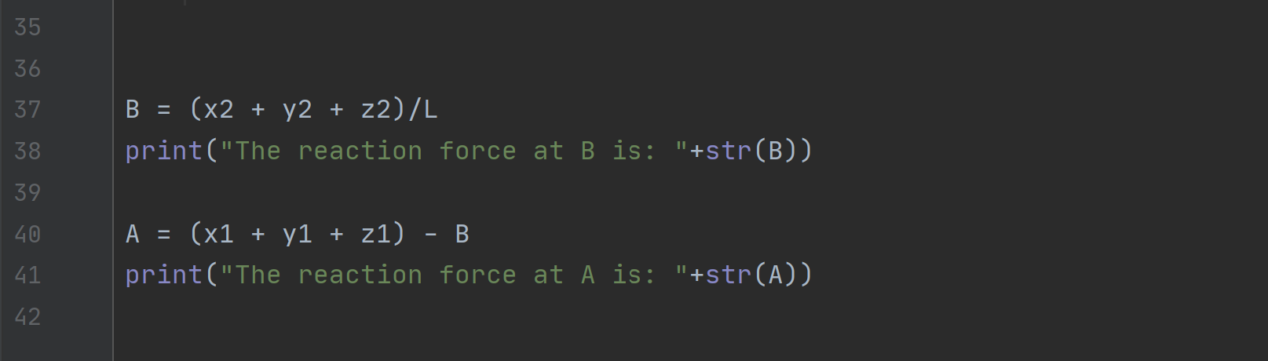
PYTHON code:

Slide 16
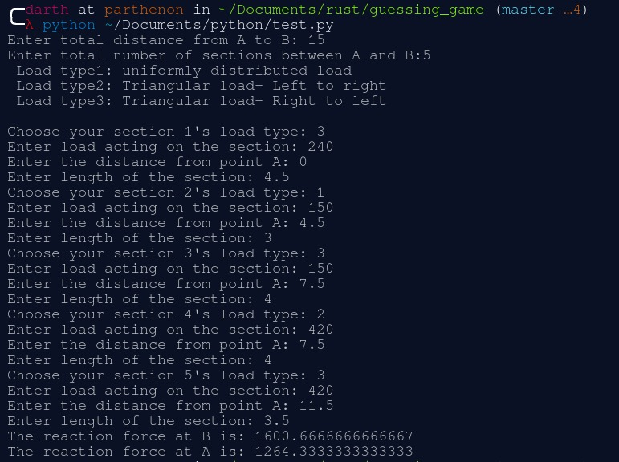
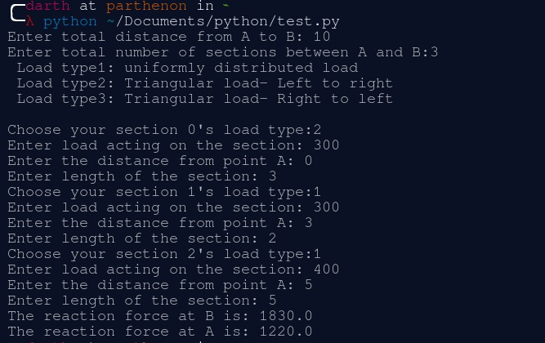
solution for b
solution for c

Slide 17
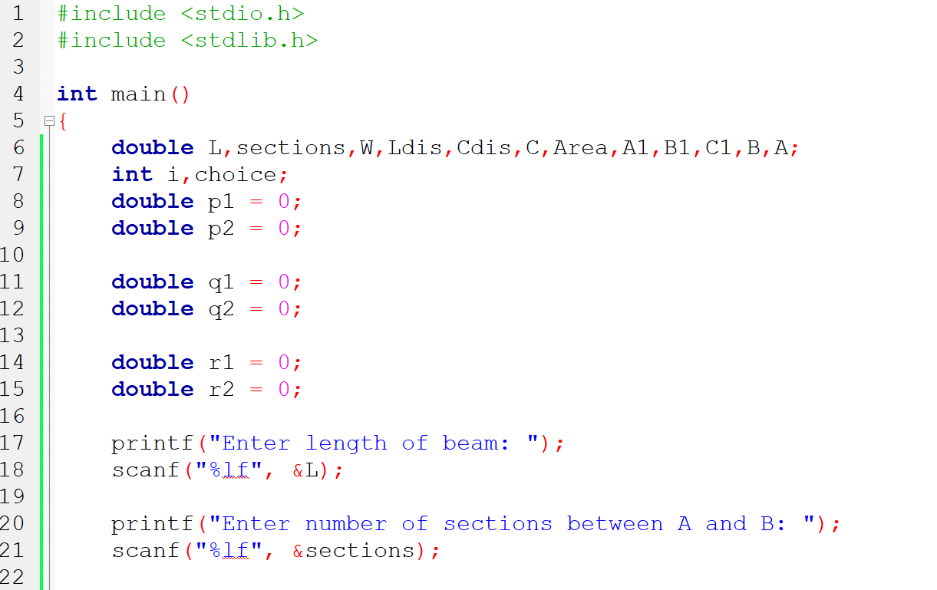
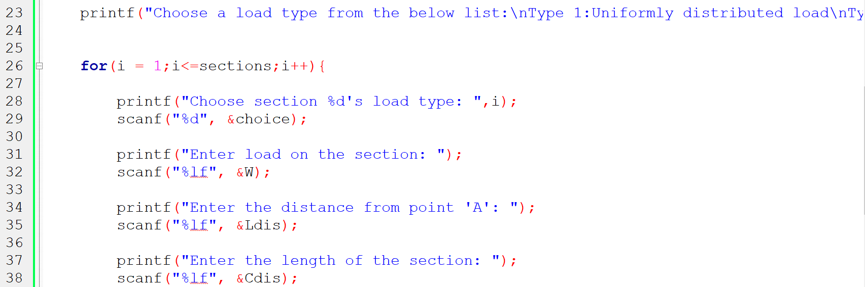
Code in C language:

Slide 18
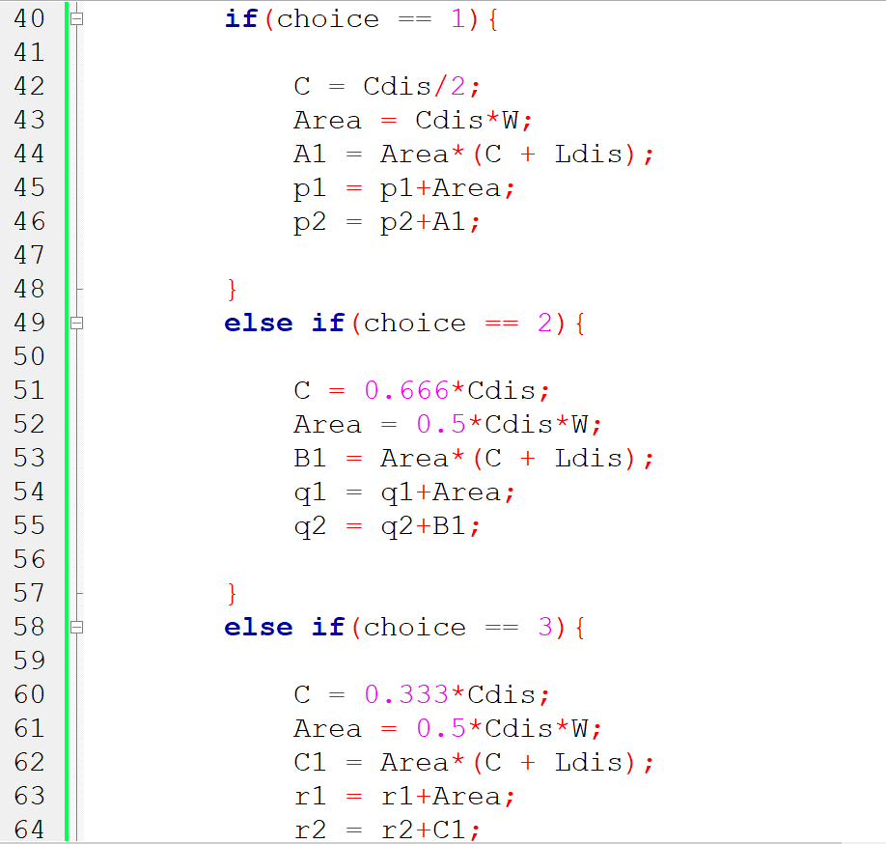
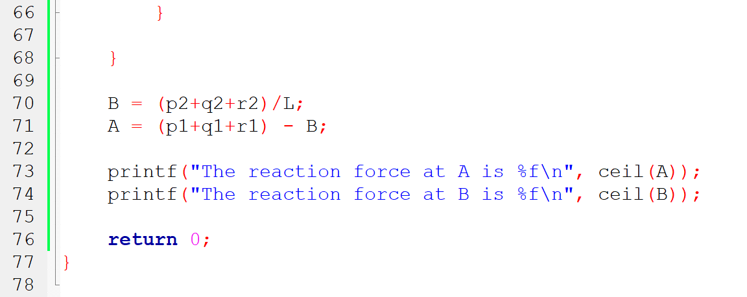

Slide 19
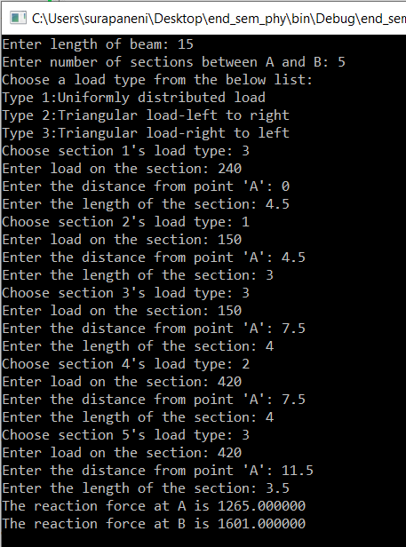
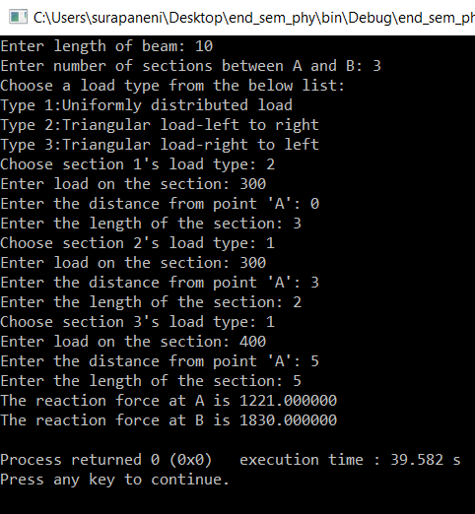
Solution for (b) using the above code:
Solution for (c) using the above code:

Slide 20


